Slide 1
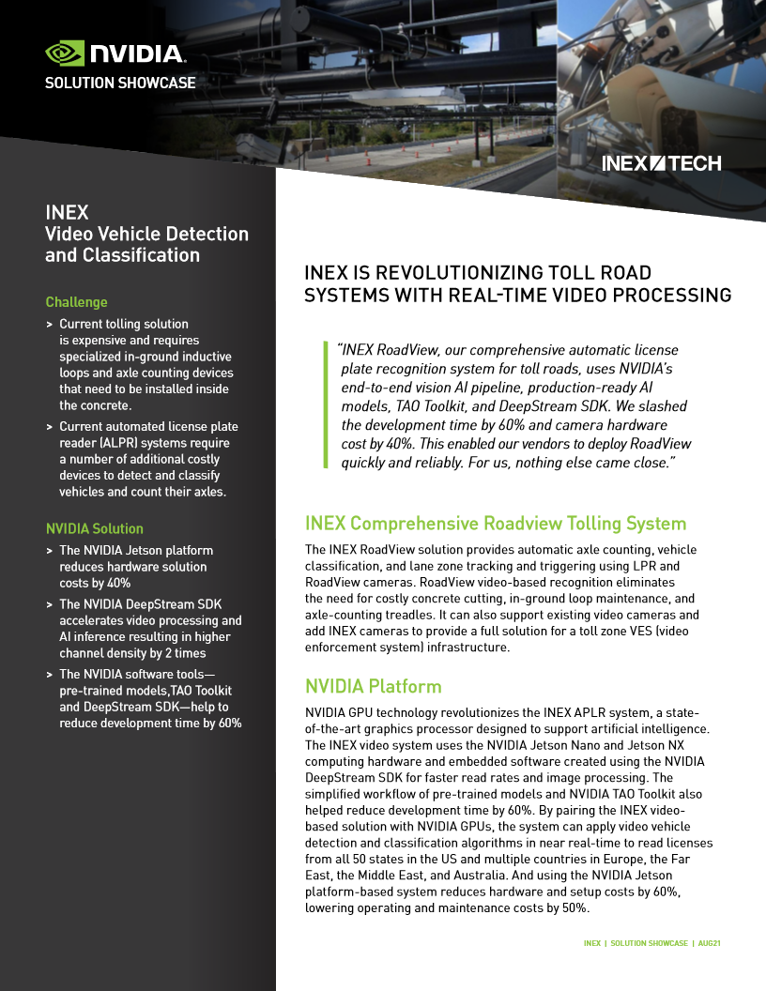
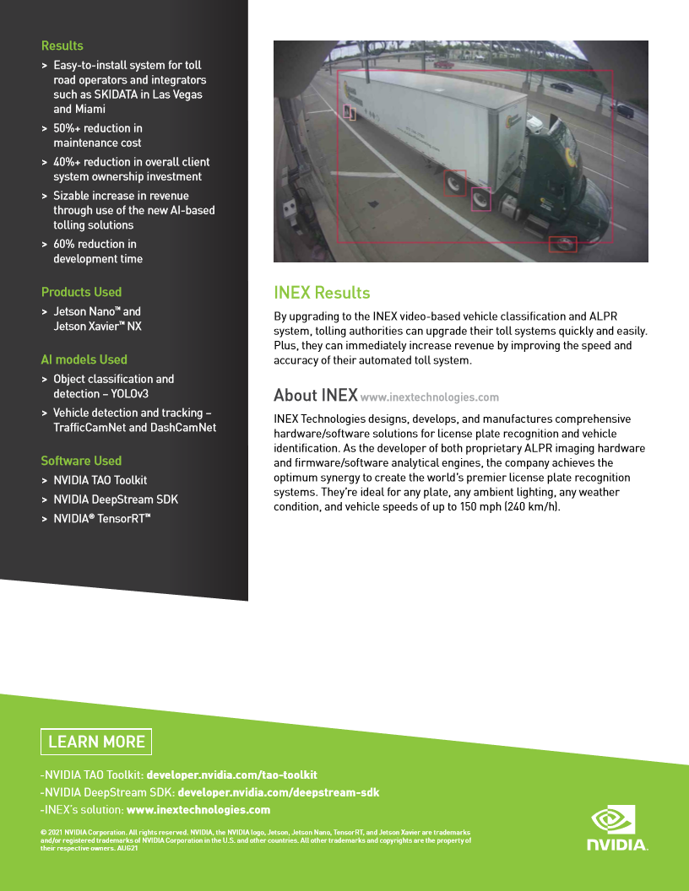

Slide 2
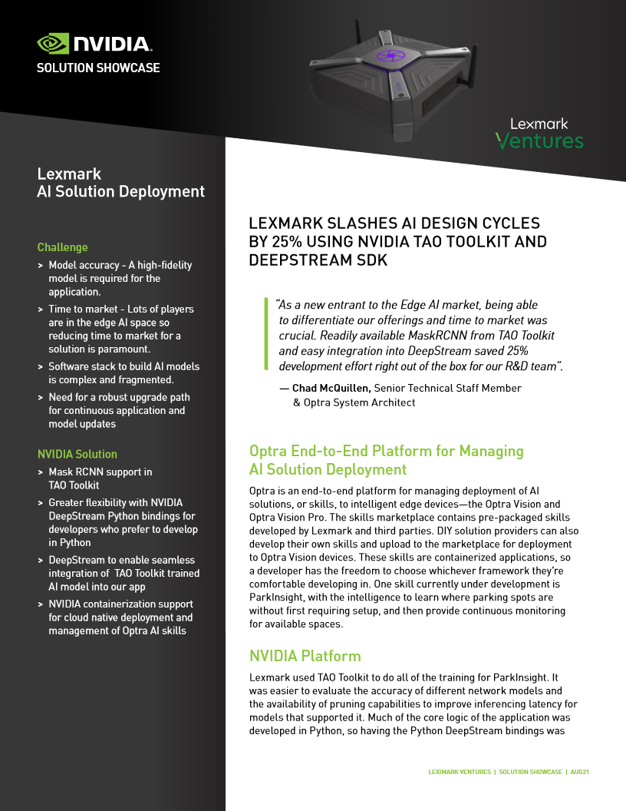
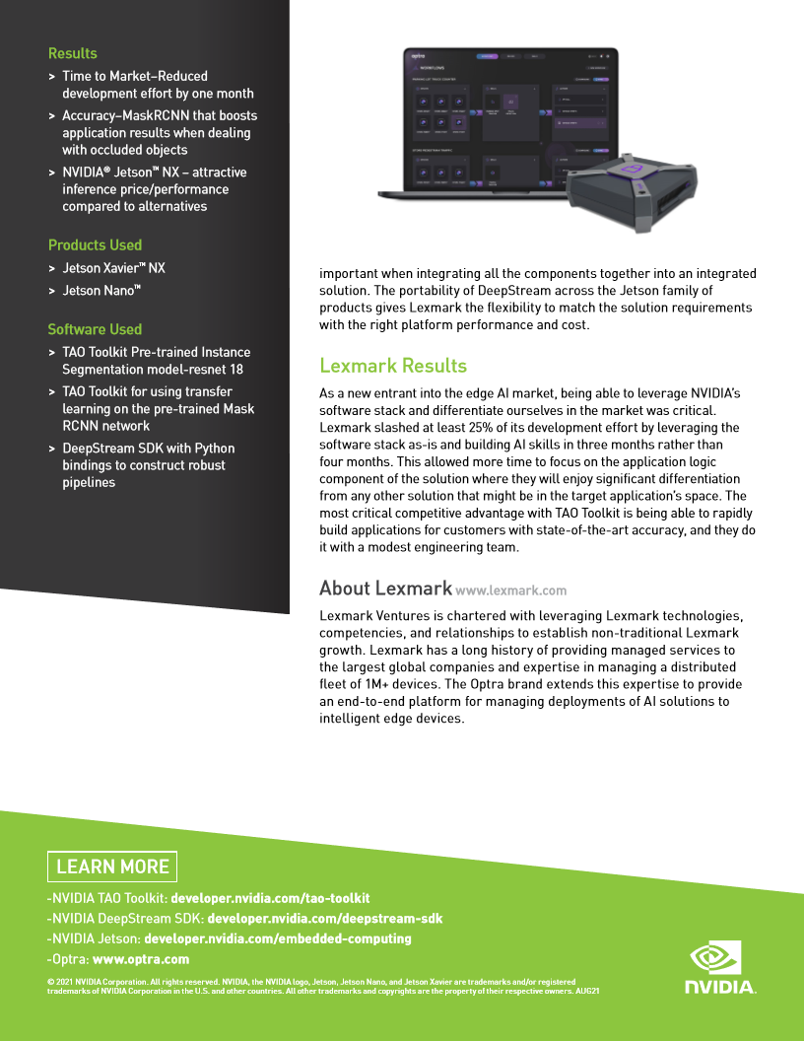

Slide 3
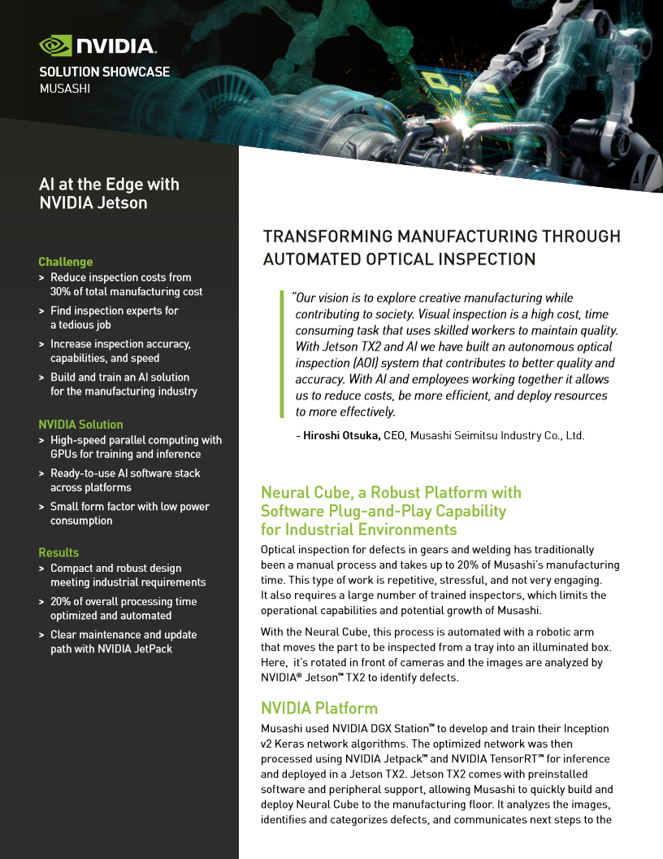
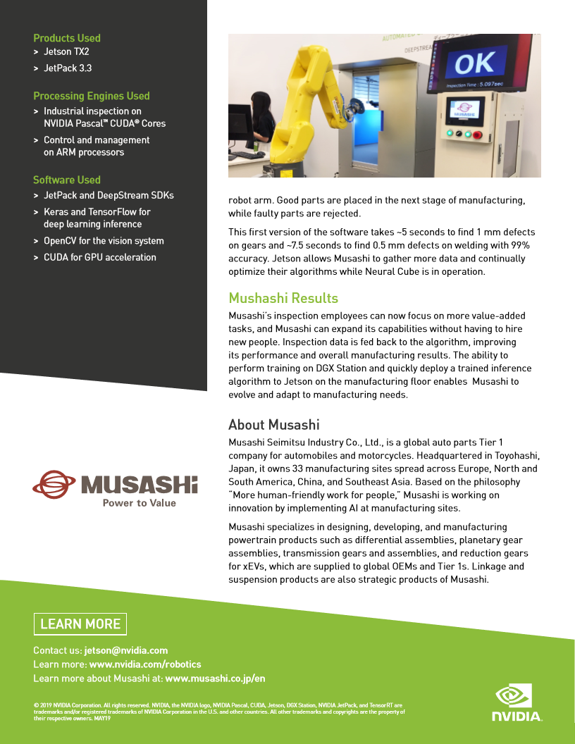

Slide 4
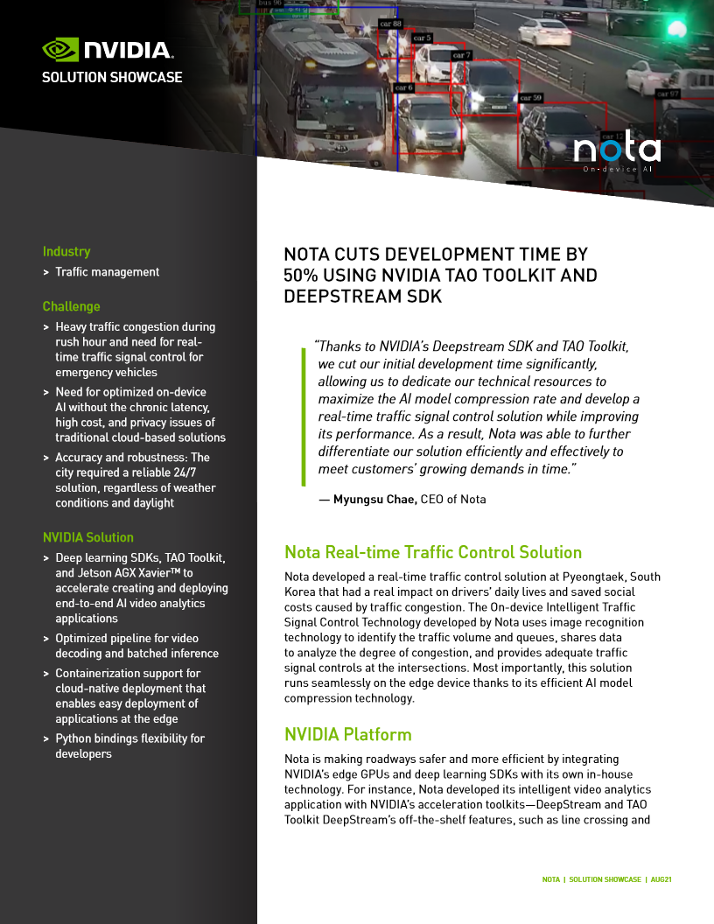
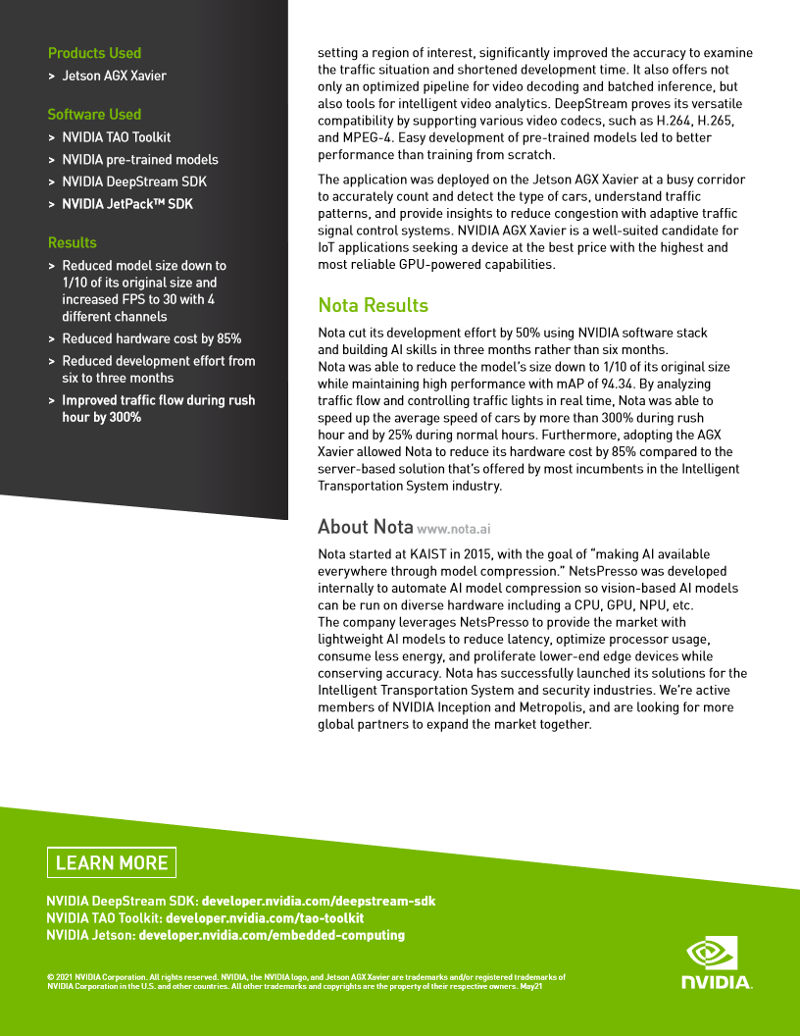
Notes:
Next we have Nota, a startup based out of Korea building smart city and smart traffic solution.
They have built their video analytic solution using DS to detect and count cars, understand traffic pattern and provide insights into congestion.
With the hardware-based acceleration in Deepstream, they are to process multi-channel inputs and guarantees that their solution could run stable and accurate even on Edge devices.
Deepstream has made it so easy to implement smart analysis. They are able to use the line crossing and region of interest features in DS to significantly improve the accuracy in examining traffic situation and shorten their development time.
Nota is leveraging AI to make roadways safer and more efficient with NVIDIA’s edge GPUs and deep learning SDKs.
Nota developed an intelligent video analytics application with NVIDIA's acceleration toolkits — DeepStream and TAO Toolkit. The application was deployed on Jetson AGX Xavier at a busy corridor to accurately count and detect the type of cars, understand traffic patterns and provide insights to reduce congestion with adaptive traffic signal control system.
Reduced development time by half and improved traffic flow by 321% during rush hour.

Slide 5
